Slide 1
ML-Based Classification of Digitally Modulated Signals
VIJAY VENKATESAN V
CB.EN.U4ECE22058

Slide 2
DIGITALLY MODUALTED SIGNALS
Digitally modulated signals are waveforms that convey information through variations in their amplitude, frequency, or phase. These signals are fundamental in digital communication systems.
Digitally modulated signals allow for efficient data transmission over various communication channels, including wireless, optical, and wired systems.
They are crucial in applications such as mobile communications, satellite transmissions, Wi-Fi, and digital broadcasting.
The ability to accurately classify these signals enhances the performance of communication systems, enabling reliable detection, decoding, and processing of transmitted information.

Slide 3
OBJECTIVE
The primary goal of this project is to develop a machine learning model capable of accurately classifying different types of digitally modulated signals
By leveraging advanced feature extraction and machine learning techniques, this project aims to improve classification accuracy and provide insights into the performance of various modulation schemes in the presence of noise and interference.

Slide 4
LITERATURE REVIEW
Recent studies highlight the effectiveness of the Sevcik Fractal Dimension (SFD) method in extracting meaningful features from modulated signals, enabling improved classification performance. Machine learning models, particularly Deep Extreme Learning Machines (DELM), have demonstrated superior capabilities in recognizing different modulation schemes due to their rapid training and modeling efficiency. Furthermore, the application of optimization algorithms like Artificial Bee Colony (ABC) has been shown to enhance classification accuracy by fine-tuning model parameters, addressing challenges posed by noise and high-dimensional feature spaces. The ADMSR-ML technique integrates these methodologies, showcasing improved classification results compared to conventional approaches through comprehensive experimental analysis.

Slide 5
METHODOLOGY
Data Collection
Feature Extraction
Model Selection
Parameter Tuning
Model Training and Evaluation
Comparative Analysis

Slide 6
DATASET
The dataset used in this project is the RML2016.10a dataset, which contains digitally modulated signals generated for various modulation schemes. It is specifically designed for research in the field of signal classification and machine learning.
Unique modulation schemes in the dataset: ['8PSK', 'AM-DSB', 'AM-SSB', 'BPSK', 'CPFSK', 'GFSK', 'PAM4', 'QAM16', 'QAM64', 'QPSK', 'WBFM']
Unique SNR values in the dataset: [-20, -18, -16, -14, -12, -10, -8, -6, -4, -2, 0, 2, 4, 6, 8, 10, 12, 14, 16, 18]
Total number of samples in the dataset: 220000
SHAPE OF EACH KEY: (1000, 2, 128)

Slide 7
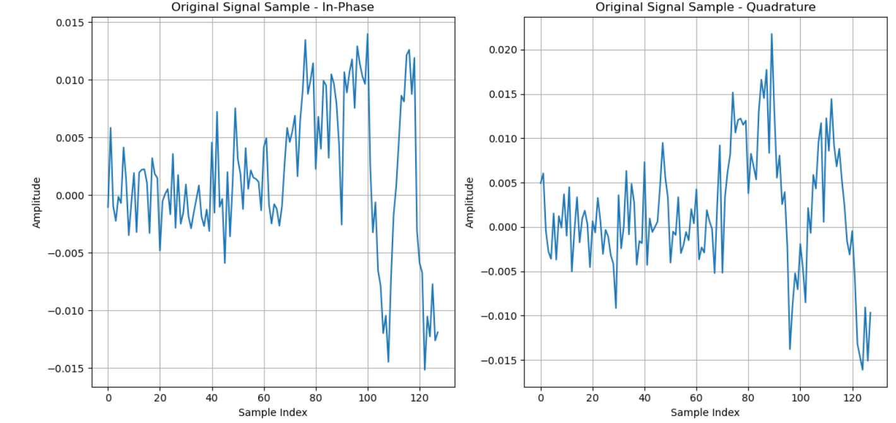
('QPSK', 2)

Slide 8
REDUCED DATASET
In this project, reducing the dataset by selecting a few modulation schemes and SNR values allows for faster evaluations of various algorithms. A smaller dataset minimizes computational demands and training times, enabling quick iterations and more efficient experimentation with different models. This streamlined approach simplifies analysis, making it easier to interpret results and draw meaningful conclusions about algorithm performance in classifying digitally modulated signals.

Slide 9
SELECTED SCHMES AND SNR VALUES
selected_modulations = ['CPFSK', '8PSK','WBFM', 'AM-SSB', 'PAM4’]
selected_snr = [10, 12, 14, 16, 18]

Slide 10
FEATURE EXTRACTION
Fractal Dimension Analysis (SFD): SFD_InPhase, SFD_Quadrature
Energy Measures: Energy_InPhase, Energy_Quadrature
Peak-to-Average Power Ratio (PAPR): PAPR_InPhase, PAPR_Quadrature
Statistical Measures:
Mean: MeanAmplitude_InPhase, MeanAmplitude_Quadrature
Variance: Variance_InPhase, Variance_Quadrature
Skewness: Skewness_InPhase, Skewness_Quadrature
Kurtosis: Kurtosis_InPhase, Kurtosis_Quadrature
Zero-Crossing Rate (ZCR): ZeroCrossingRate_InPhase, ZeroCrossingRate_Quadrature

Slide 11
NORMALIZATION
I performed Z-score normalization on the numeric features of the dataset using the StandardScaler from scikit-learn. This method standardizes the values by subtracting the mean and dividing by the standard deviation for each feature. As a result, all features now have a mean of 0 and a standard deviation of 1. This normalization helps ensure that each feature contributes equally to the model's training process.

Slide 12
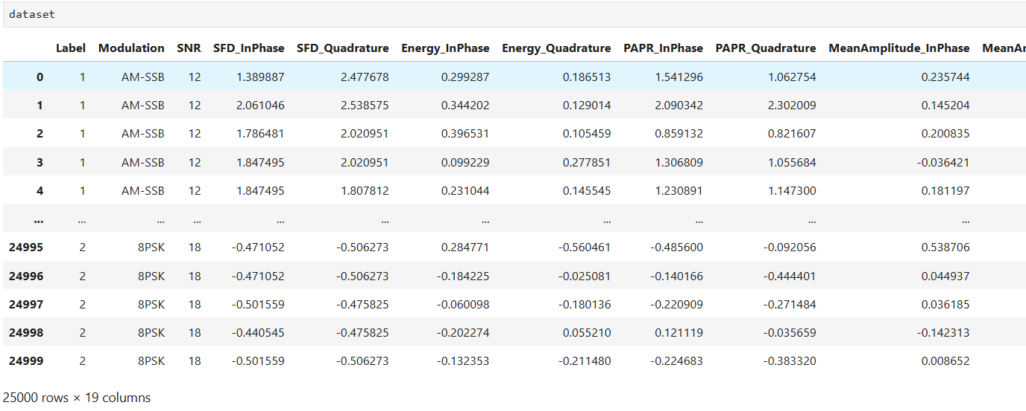
DATASET

Slide 13
Data Preparation
Dropping Missing Values:
dataset.dropna(inplace=True) removes any rows with NaN values, ensuring the dataset is clean and usable for analysis.
Feature Selection:
X is defined to include specific features such as SNR and various statistical measures, while y is set to the 'Label' column representing the target variable.
Encoding Categorical Variables:
The LabelEncoder is used to transform the 'Modulation' column into numeric values, making it suitable for machine learning algorithms.

Slide 14
Data Splitting: Training and Testing Sets
The dataset is split into training and testing sets using an 80-20 split. The training set contains 80% of the data, while the test set holds the remaining 20%.
Check the distribution of classes in the training and test sets
Training set class distribution: {0: 4000, 1: 4000, 2: 4000, 3: 4000, 4: 4000}
Test set class distribution: {0: 1000, 1: 1000, 2: 1000, 3: 1000, 4: 1000}

Slide 15
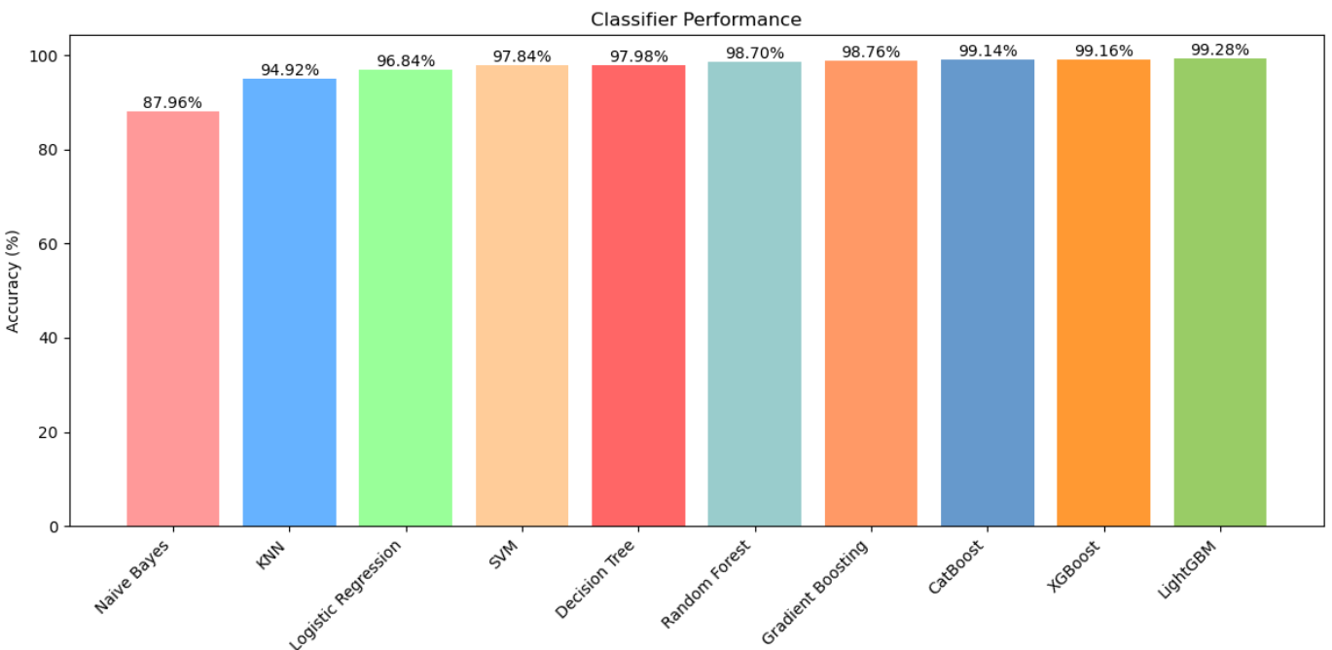
Classifier Performance Analysis

Slide 16
INFERENCE
These results indicate a clear trend: the ensemble algorithms, such as Random Forest, Gradient Boosting, XGBoost, CatBoost, and LightGBM, consistently outperform the traditional classifiers. This can be attributed to their ability to combine multiple models to improve prediction accuracy, effectively reducing variance and bias.

Slide 17
HYPERPARAMETER TUNING
Random Forest: 99.22%
Best parameters: {'max_depth': 20, 'min_samples_split': 5, 'n_estimators': 200}
SVM: 98.84%
Best parameters: {'C': 10, 'kernel': 'linear'}
Decision Tree: 98.72%
Best parameters: {'criterion': 'entropy', 'max_depth': None, 'min_samples_split': 2}
Logistic Regression: 97.94%
Best parameters: {'C': 10, 'solver': 'lbfgs'}
KNN: 95.96%
Best parameters: {'n_neighbors': 5, 'weights': 'distance'}

Slide 18
STACKING
 | Naive Bayes | Decision Tree | Random Forest | Gradient Boosting | KNN | SVM | XGBoost | LightGBM | CatBoost
Naive Bayes | - | 98.7 | 99.28 | 99.06 | 97.24 | 98.86 | 99.64 | 99.62 | 99.46
Decision Tree | 98.7 | - | 99.24 | 99.22 | 98.88 | 99 | 99.62 | 99.52 | 99.48
Random Forest | 99.28 | 99.24 | - | 99.26 | 99.24 | 99.38 | 99.58 | 99.54 | 99.44
Gradient Boosting | 99.06 | 99.22 | 99.26 | - | 99.06 | 99.26 | 99.6 | 99.52 | 99.46
KNN | 97.24 | 98.88 | 99.24 | 99.06 | - | 99.06 | 99.6 | 99.6 | 99.46
SVM | 98.86 | 99 | 99.38 | 99.26 | 99.06 | - | 99.62 | 99.6 | 99.54
XGBoost | 99.64 | 99.62 | 99.58 | 99.6 | 99.6 | 99.62 | - | 99.62 | 99.58
LightGBM | 99.62 | 99.52 | 99.54 | 99.52 | 99.6 | 99.6 | 99.62 | - | 99.58
CatBoost | 99.46 | 99.48 | 99.44 | 99.46 | 99.46 | 99.54 | 99.58 | 99.58 | -

Slide 19
INFERENCE
Initially, standalone classifiers like Random Forest (99.22%), XGBoost (99.16%), and LightGBM (99.28%) demonstrated strong performance; however, stacking combinations significantly enhanced these results. For instance, the pairing of Naive Bayes with XGBoost achieved the highest accuracy at 99.64%, illustrating the effectiveness of leveraging diverse models. Even classifiers with lower standalone performance, such as Naive Bayes (88.94%) and KNN (95.96%), benefited from stacking, showcasing a remarkable boost in their predictive capabilities. Overall, the stacking approach not only improved accuracy metrics but also highlighted the robustness of ensemble methods in enhancing model performance and achieving better generalization in classification tasks.

Slide 20
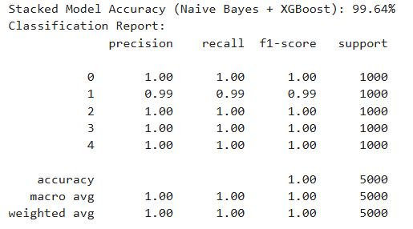
BEST COMBINATION
NAÏVE BAYES + XGBOOST

Slide 21
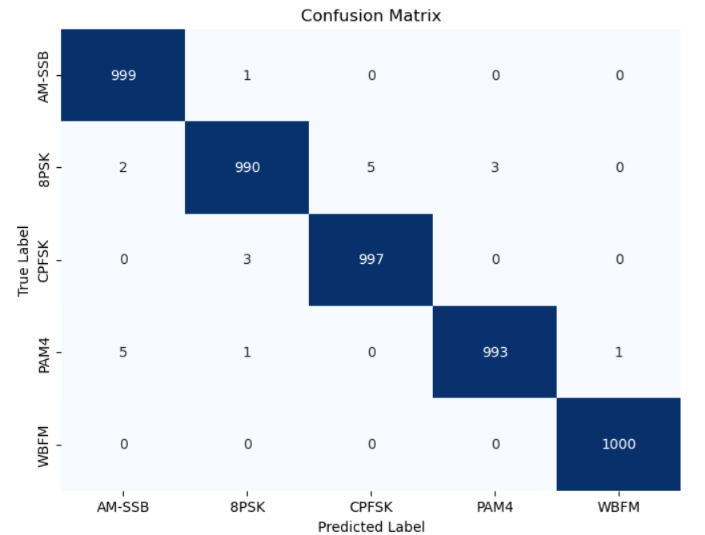
CONFUSION MATRIX FOR NB+XG MODEL

Slide 22
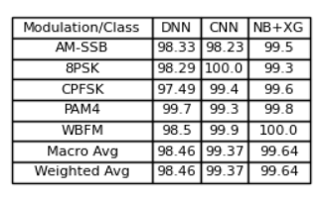
PRECISION

Slide 23
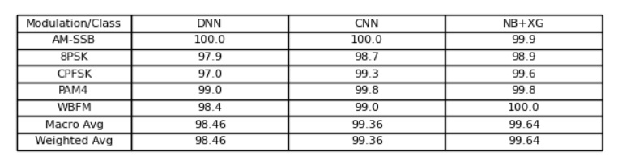
RECALL

Slide 24
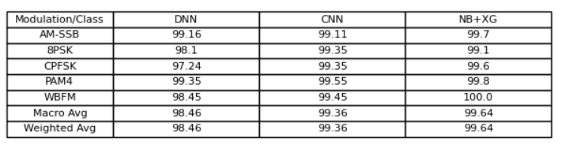
F1-SCORE

Slide 25
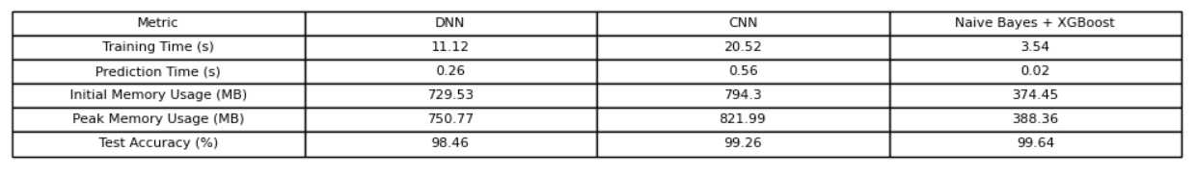
COMPARITIVE ANALYSIS

